Slide 1
CS 251
JUMPSTART
5
PROJECT
mymap
Raka Primardika - Leeza Andryushchenko

Slide 2
JUMPSTART RECORDING LINK
https://uic.zoom.us/rec/share/K61rREde2WJ7jNA15lACHgG2khy8sIMLD10BugeGasG5EGXJwDPYbE-Ff579CNcf.TDWjhtcMlmkYaoLe
we have annotations
that aren't in the slides

Slide 3
project jumpstart?
It is exactly what it sounds. It is a session to "jumpstart" you on the project. The TAs will prepare a presentation to guide you in starting the project. If you find reading long project descriptions overwhelming, this is for you!
They will first describe the project, answering any questions along the way. They will then help point you to course resources you may need to review to complete the project. They will lay out a project timeline, what to tackle first, etc. They will help you lay out different cases, edge cases, error handling, and more. They will help you brainstorm approaches, implementations, etc. They will give you time to map out your plan and ask questions.
Most importantly, the TAs will get you started. Sometimes the hardest part of doing any project is... getting started.
If you find yourself struggling to get started on projects for any reason (e.g. motivation, feeling overwhelmed by all the information, etc.), then Project Jumpstart is for you. If you would like to improve your project management skills, Project Jumpstart is for you. If you prefer listening and discussing rather than reading, Project Jumpstart is for you. If you need accountability, Project Jumpstart is for you. If you like the idea of being more efficient with your approach to solving problems, this might really help you.

Slide 4
LET'S GET SOME THINGS CLEAR
PROJECT 5 IS CHALLENGING
YOU MUST, AND WILL, DIAGRAM
YES, JUMPSTART IS 69 SLIDES
nice
DEBUGGING IS ANNOYING
TIME/WORK MANAGEMENT IS TESTED
DRINK TEA (or a red bull) & HAVE FUN

Slide 5
POINTER
CS 251
FUN
https://open.spotify.com/playlist/1sm0QpnMpFG6WyTDaTp0hx?si=9a286588e9774f46

Slide 6
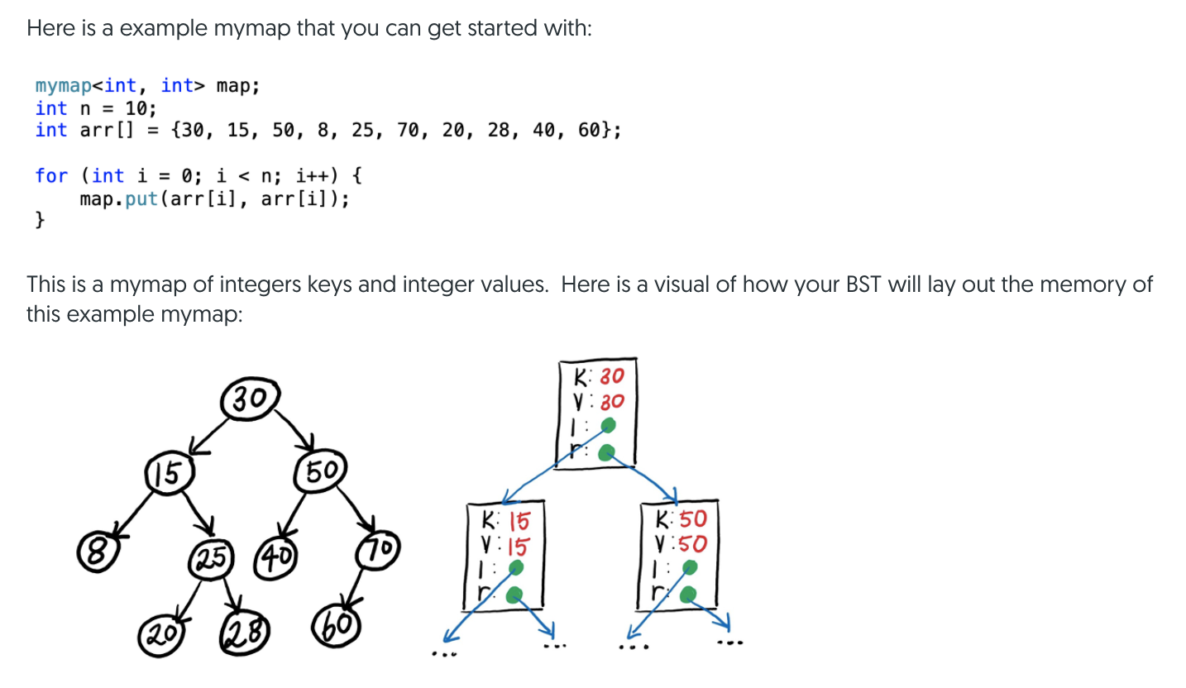
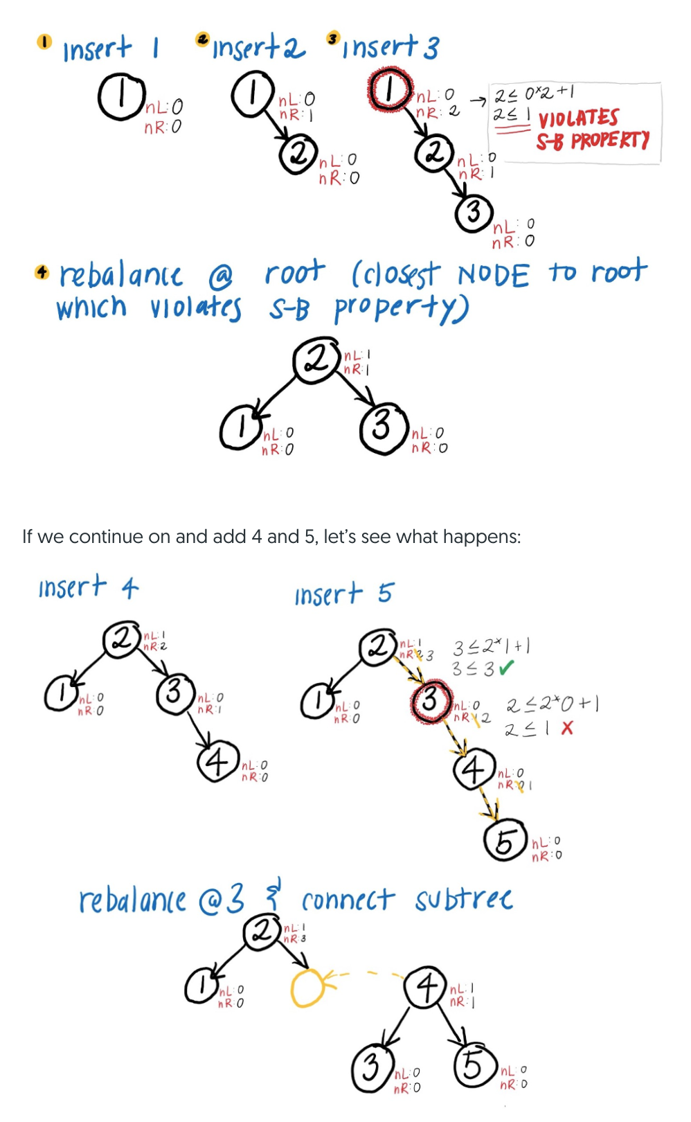
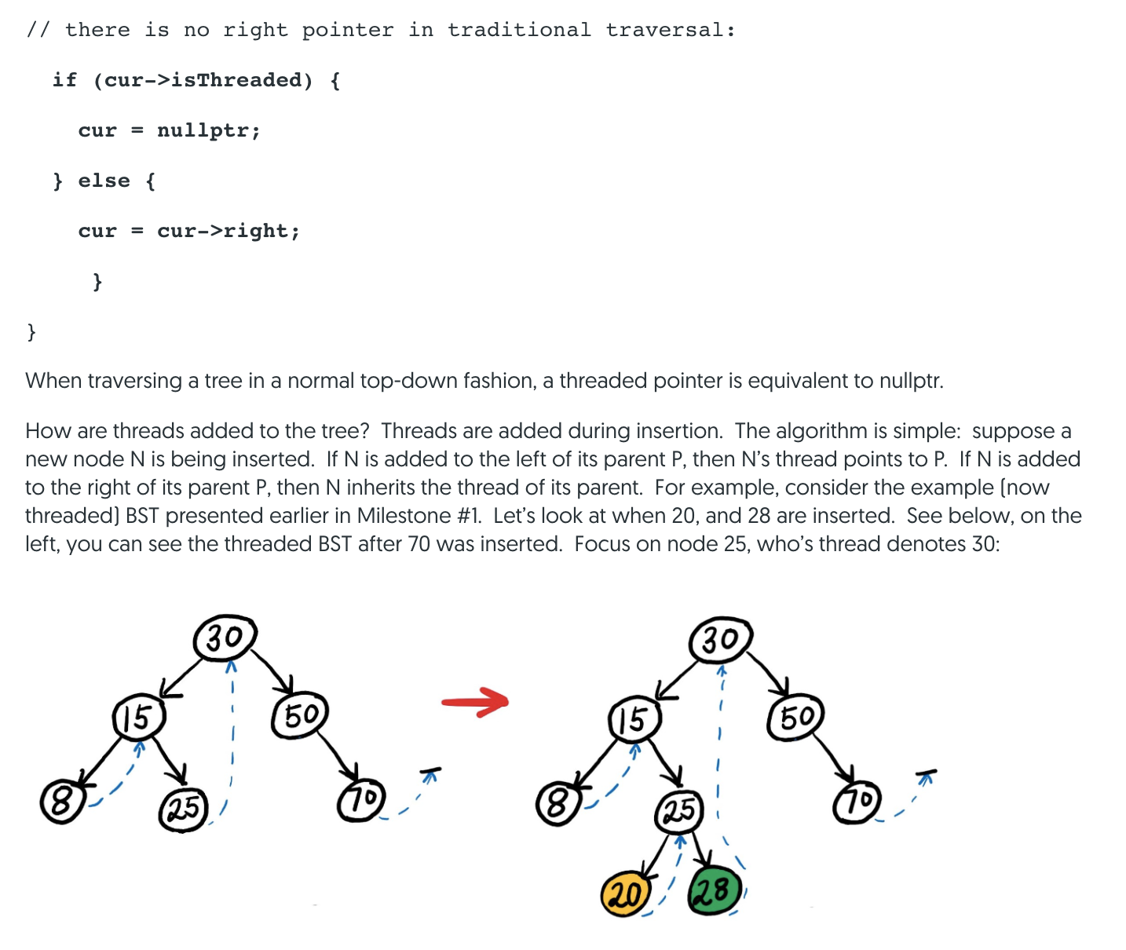
PROJ DESC HAS COOL DRAWINGS

Slide 7

EXTRA CREDIT
DEADLINE
WEDNESDAY, OCTOBER 27th

Slide 8

GOOD NEWS!
JUST IMPLEMENTING ONE CLASS
NO APPLICATION
NO FILE READING & STRING PARSING
NO GDB MAZE STUFF
BUT START IMMEDIATELY

Slide 9
there's no way to say this nicely
TOUGH PROJECT
if you're stuck for 20+ minutes, step away & take a break

Slide 10
BAD HABITS
CODING DIRECTLY
NOT TESTING THOROUGHLY
NOT USING GDB FOR SEG FAULTS
STARTING LATE

Slide 11
"Your tests.cpp should have 100s of assertions for each public member function"
quantity
thorough
repeating asserts
stress testing
same test twice+
edge case testing
assert & expect on same thing
different data types

Slide 12
TESTING REQUIREMENTS
20 points: Your tests.cpp file will be run against correct and incorrect implementations of mymap.h files and you will be graded based on how thorough your testing is. To receive full credit for testing you must have tests for the following cases:
1. put, get, Size, [], contains (check Size after put, get after put) for balanced trees, on keys that do not exist, on duplicate keys,
2. foreach (test foreach loop, begin(), order is correct, etc.),
3. equal operator, (tests Size, toString, toVector, and ==);
4. clear (tests Size, toString, toVector, copy operator, copy constructor);
5. checkBalance on small trees (10-15 elements), on various insertion orders that trigger rebalances.
You must also have mymaps of the following types: all unique keys inserted, with duplicate keys inserted, balanced trees, unbalanced trees, big mymap (>1000s elements, requires loop), mymap with randomly generated keys/values, mymap where insertion is in ascending/descending order.
Lastly, you must test on all types: ints, doubles, strings, chars (matching and mixed key/value types). 1+ pt deduction for each test missing.

Slide 13
VARIOUS TREES
INSERTION ORDER | TYPE OF TREE
 | EMPTY TREE, OF COURSE LOL
1 | SINGLE NODE EDGE CASE
30,15,50,8,25,70,20,28,40,60 | SMALL, BALANCED, LEAN LEFT
1,2,3,4,5,6,7,8,9,10 | SMALL, IMBALANCED, LEAN RIGHT
10,9,8,7,6,5,4,3,2,1 | SMALL, IMBALANCED, LEAN LEFT
5,2,7,1,3,6,9,4,8,10 | SMALL, BALANCED, LEAN RIGHT
1,10,2,9,3,8,4,7,5,6 | SMALL, IMBALANCED, ZIGZAG RIGHT
for (i=1;i<=1000000;i++) map.put(randomInteger); | BLOODY ENORMOUS, MAY BE IMBALANCED, RANDOM
8,4,12,2,6,10,14,1,3,5,7,9,11,13,15 | MEDIUM, PERFECTLY BALANCED
8,7,9,6,10,5,11,4,12,3,13,2,14,1,15 | MEDIUM, IMBALANCED NOT AT ROOT
1,2,3,4,5 | TINY, NEEDS 2 REBALANCES
Binary Search Tree Visualization

Slide 14
GAME PLAN
https://en.wikipedia.org/wiki/Test-driven_development
WRITE
PLAN
WRITE
RUN
TESTS
CODE
CODE
TESTS
REPEAT.
think about what the functions should do, from user's perspective
only then do you implement those functions accordingly
easier to spot edge cases & other considerations

Slide 15
EXAMPLE STRESS TEST
TEST(mymap, Milestone1_Everything) {
// test to compare with C++ map
mymap<int, int> mapMine;
map<int,int> mapSol;
int n = 1000000; // # of elements inserted
// fill up BOTH maps
for (int i = 1; i <= n; i++) {
int key = randomInteger(0,10000); // given
int val = randomInteger(0,10000);
mapMine.put(key, val);
mapSol[key] = val;
}
// 1. Assert sizes are equal
EXPECT_EQ(mapMine.Size(), mapSol.size());
// 2. String test (order is correct)
stringstream solution("");
// Fill string stream with mapSol
for (auto e : mapSol) {
solution << "key: " << e.first;
solution << " value: " << e.second << endl;
// 3. Test map contents
EXPECT_TRUE(mapMine.contains(e.first));
EXPECT_EQ(mapMine.get(e.first), e.second);
}
EXPECT_EQ(mapMine.toString(), solution.str());
}

Slide 16
NOTES ON TESTING
This is just to get you started about writing smart tests. There is so much more you should do. Do not post on Piazza or come to office hours asking why you are failing a test case in the autograder. If we wanted you to see the output, input, or anything else, we would have made this visible. If you are not passing, you need to write more tests to determine why your code is not functional or does not meet the spec. All the details of the mymap implementation are provided in the handout and in the comments of the starter code.
TEST, TEST AND TEST SOME MORE!

Slide 17


C++ MAP
C++ Map Reference
Project 2
Project 3
Member functions
(constructor)
(destructor)
operator=
Iterators:
begin
end
rbegin
rend
cbegin
cend
crbegin
crend
Modifiers:
insert
erase
swap
clear
emplace
emplace_hint
Capacity:
empty
size
max_size
Element access:
operator[]
at
Observers:
key_comp
value_comp
O(logN)

Slide 18
BINARY SEARCH TREE
ROOT
LEFT SIDE SMALLER
RIGHT SIDE LARGER
50
33
89
7
41
66
91

Slide 19
Binary Search Tree Reference Doc for
Project 5 - mymap
CS 251 Fall 2021
WARNING: This is simply a reference. Copy-pasting and then changing variable names simply won’t cut it and will most likely get you even more confused. Instead, go through this BST class slowly and try to understand how it works. How do the recursive functions work? When do you need prev pointers? Diagram it. Once you have a good understanding, you’re ready to take on Milestone 1.
NOTES: Relevant stuff highlighted in orange.
We made additional comments that will be in ## bold orange
JUMPSTART: Raka Primardika
Leeza Andryushchenko

Slide 20
mymap<keyType,valueType>
struct NODE {
keyType key; // used to build BST
valueType value; // stored data for the map
NODE* left; // links to left child
NODE* right; // links to right child
int nL; // number of nodes in left subtree
int nR; // number of nodes in right subtree
bool isThreaded; // marks threaded node
};
NODE* root; // pointer to root node of the BST
int size; // # of key/value pairs in the mymap

Slide 21
1
9
FUNCTION
// Default Constructor
FUNCTION
begin()
FUNCTION
2
put(key, value)
FUNCTION
10
end()
FUNCTION
3
Size()
FUNCTION
11
clear()
FUNCTION
4
contains(key)
FUNCTION
12
operator=
FUNCTION
5
FUNCTION
13
get(key)
// Copy Constructor
FUNCTION
6
FUNCTION
14
toString()
// Destructor
FUNCTION
7
operator[]
FUNCTION
15
toVector()
FUNCTION
8
operator++
FUNCTION
16
checkBalance()

Slide 22
1
BASIC FUNCTIONS
MILESTONE
MILESTONE
2
THREADING
MILESTONE
3
FOR-EACH LOOPS
MILESTONE
4
COPY AND CLEAR
MILESTONE
5
A BALANCING ACT

Slide 23
1
MILESTONE
BASIC FUNCTIONS

Slide 24
1
MILESTONE
WEEK 8 LECTURES!!!
toString()
put(key, value)
Size()
operator[]
// Default Constructor
get(key)
contains(key)

Slide 25
1
MILESTONE
TESTING
easy, compare with the C++ map
TEST {
mymap<TYPE1, TYPE2> testMe;
map<TYPE1, TYPE2> correct;
testMe.put(val1, val2);
correct.emplace(
pair<TYPE1,TYPE2>(val1, val2));
// check if key exists:
EXPECT_EQ(true,
testMe.contains(val1));
// check the values:
EXPECT_EQ(testMe.get(val1),
correct[val]);
EXPECT_EQ(testMe[val1],
correct[val1]);
// try to make this test
// repetitive using loops
}
TEST {
mymap<TYPE1, TYPE2> test;
stringstream dump();
int n = 30;
// add some values:
for(int i = n; i > 0; i--)
{
// put values
test.put(i, i);
// build stringstream:
dump << “key: “ << i
<< “ ” << “value: “ <<
i << “\n”;
}
// test toString output
ASSERT_EQ(dump.str(),
test.toString());
}
TEST {
// from project pdf:
mymap<int, int> test;
map<int, int> correct;
int seed = 1000000;
for(int i = 0; i < 10000;
i++) {
// randomize key and val
int k = randInt(seed);
int v = randInt(seed);
test.put(k, v);
correct[k] = v;
}
EXPECT_EQ(test.size(),
correct.size());
// after this point test
// test inserts and string
// like in first 2 tests
}
COPY-PASTING WON'T WORK
access
stringstream
stress testing
Notes:
NOTE: if you just copy-paste this and other tests in the slides they most likely won’t compile because this is just a reference for the logic rather than provided testing code. This represents testing logic (what asserts to do, how to stress test, etc.) so please use this as a reference

Slide 26

1
1
3
BST
MILESTONE
FUNCTION
FUNCTION
// Default Constructor
Size()
struct NODE {
keyType key; // used to build BST
valueType value; // stored data for the map
NODE* left; // links to left child
NODE* right; // links to right child
int nL; // number of nodes in left subtree
int nR; // number of nodes in right subtree
bool isThreaded;
};
NODE* root; // pointer to root node of the BST
int size; // # of key/value pairs in the mymap
YOU KNOW THE DRILL

Slide 27
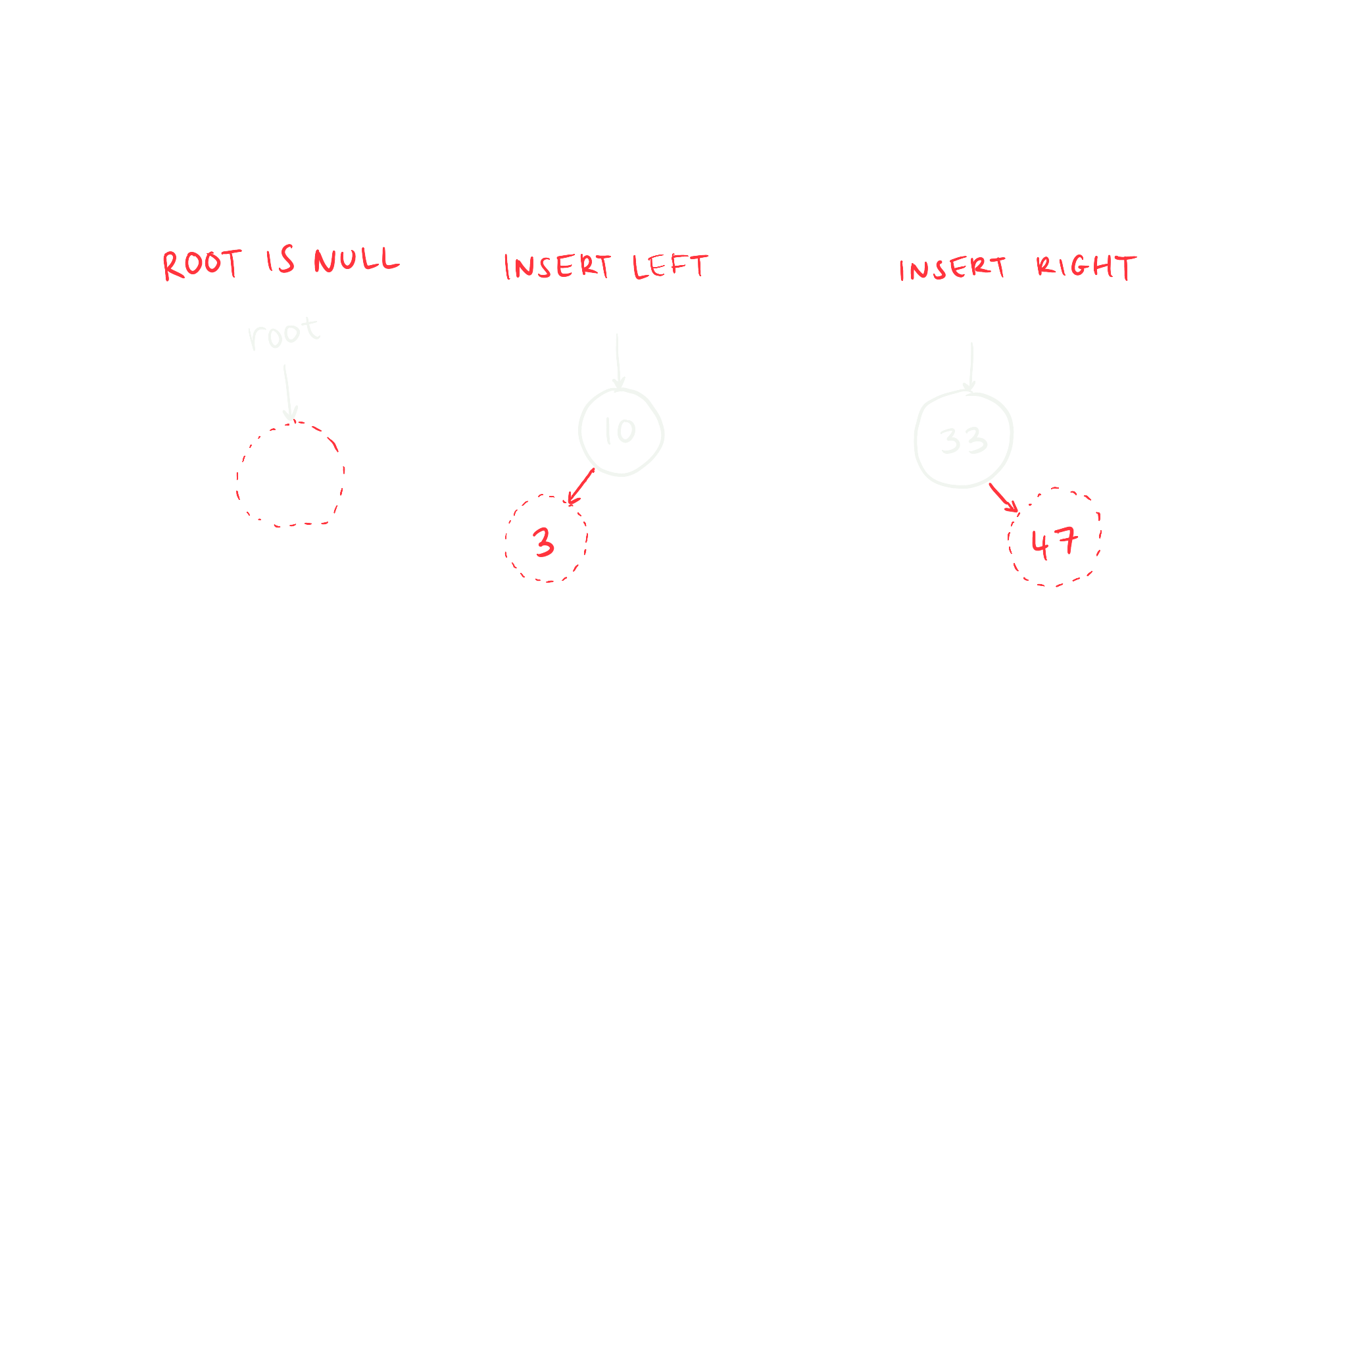
1
2
BST
MILESTONE
FUNCTION
put(key, value)
Inserting a new node into the Binary Search Tree (BST)
Considerations
NODE
All nodes added are leaves
Create a new node, initialize values
keyType key; valueType value;
NODE* left;
NODE* right;
int nL;
int nR;
bool isThreaded;
If keys equal, update value
With traversal pointers, move through the BST
A prev pointer to link
Compare the keys between the current and new nodes
Increment size
When you’ve hit a leaf, link the tree to the new node

Slide 28
1
4
5
BST
MILESTONE
FUNCTION
FUNCTION
contains(key)
get(key)
These two functions are actually almost identical in implementation
One returns true/false, the other returns key value/default value
Copy-paste to save time! Or decompose functions...
A curr pointer would be useful
curr
ROOT
contains(66) == true
50
Buck
66 == 50
66 > 50
get(66) == “Rory”
33
Ella
89
Adam
66 == 89
66 < 89
7
Jack
41
Chen
66 == 66
66
Rory
91
Mick

Slide 29
1
6
BST
MILESTONE
FUNCTION
toString()
Similar to a dump function, output contents of map IN ORDER
Big hint: Use string streams to build the string recursively
ROOT
key: 7 value: Jack
key: 33 value: Ella
key: 41 value: Chen
key: 50 value: Buck
key: 66 value: Rory
key: 89 value: Adam
key: 91 value: Mick
50
Buck
33
Ella
89
Adam
7
Jack
41
Chen
66
Rory
91
Mick
RECURSION!

Slide 30
1
BST
MILESTONE
RECURSIVE
TRAVERSAL
Idea is to treat subtrees as their own BST
string toString() {
stringstream ss;
_buildString(root, ss);
return ss.str();
}
ROOT
50
Buck
okay, what is this?
33
Ella
89
Adam
_buildString(NODE* node, ostream& out) {
// Base case, node is null, do nothing
// Do something here, add to out
// Think about pre/post/in order
out << “something here” << endl;
}
7
Jack
41
Chen
66
Rory
91
Mick
Convention is to have underscores (_) for private recursive member functions

Slide 31
1
7
BST
MILESTONE
FUNCTION
operator[key]
Return the value for a given key
If key not found, insert new node to BST with that key
If key not found, return default value
This sounds familiar?
FOLLOW get's CODE
Difference is, in the event that the key is not in the map,
Insert a new node to the tree, with default value

Slide 32
MILESTONE
2
THREADING

Slide 33
MILESTONE
2
NON-THREAD
ROOT
ORDER
50
7, 33, 41, 50, 66, 89, 91
33
89
7
41
66
91

Slide 34
MILESTONE
2
THREADING
say what now??
ROOT
Every leaf’s right pointer is no longer nullptr
It’s going to point to the next element in order
ORDER
50
Keep track of isThreaded for every node
7, 33, 41, 50, 66, 89, 91
33
89
7
41
66
91

Slide 35
MILESTONE
2
apply some
MODIFICATIONS
FUNCTION
2
put(key, value)
FUNCTION
4
contains(key)
FUNCTION
5
get(key)
FUNCTION
6
toString()
FUNCTION
7
operator[]
do not modify MS1 testing code

Slide 36


MILESTONE
2
IN A NUTSHELL
INSERTIONS
FUNCTION
2
put(key, value)
insert left
insert right
N’s thread is its parent node
N’s thread is its parent’s old thread
change every
curr = curr->right;
to an if-statement
curr = (curr->isThreaded) ? nullptr : curr->right;

Slide 37
MILESTONE
2
TERNARY
review
what is this?
curr = (curr->isThreaded) ? nullptr : curr->right;
<variable> = <condition> ? <expression if true> : <expression if false>;
int x;
if (a < 10) {
x = a;
} else {
x = 10;
}
<- same ->
int x = (a < 10) ? a : 10;
Using this is not required, of course, but it saves the number of lines

Slide 38
MILESTONE
2
VISUALISED
ROOT
ROOT
ROOT
ROOT
ROOT
50
50
50
5
50
1
33
33
89
33
89
2
3
4
41
ROOT
ROOT
ROOT
6
50
7
50
8
50
33
89
33
89
33
89
7
41
7
41
91
7
41
66
91

Slide 39
MILESTONE
2
TESTING
no additional tests required, right?
just make sure all your previous ones still work

Slide 40
MILESTONE
3
FOR-EACH LOOPS

Slide 41
MILESTONE
3
FOR-EACH LOOPS
as you know,
you can do this with a map
map<int,string> map;
for (auto& p : map) {
cout << p.first;
cout << p.second;
}
implement this in your mymap
FUNCTION
8
operator++
FUNCTION
9
begin()

Slide 42
MILESTONE
3
TESTING
TEST {
mymap<int, int> test;
map<int, int> correct;
int seed = 1000000;
for(int i = 0; i < 10000; i++) {
// randomize key and val
int k = randInt(seed);
int v = randInt(seed);
test.put(k, v);
correct[k] = v;
}
stringstream ss();
for (int key : test) {
// it does work like this
ss << “key: “ << key <<
“ value: “ << test[key]
<< endl;
}
// loop should be in order
ASSERT_EQ(test.toString(),
ss.str());
}
COPY-PASTING WON'T WORK
stress test, stringstream, for-each
Notes:
NOTE: if you just copy-paste this and other tests in the slides they most likely won’t compile because this is just a reference for the logic rather than provided testing code. This represents testing logic (what asserts to do, how to stress test, etc.) so please use this as a reference

Slide 43
MILESTONE
3
9
FUNCTION
begin()
ROOT
return pointer to leftmost node
50
Buck
Use a curr pointer that only goes left until it stops
Then you can return iterator(curr)
33
Ella
89
Adam
Think about function decomposition for this
7
Jack
41
Chen
66
Rory
91
Mick

Slide 44
MILESTONE
3
8
FUNCTION
operator++
Located in the private iterator class, curr is a member variable
advance curr to the next in-order node
if (curr->isThreaded) ...
THREADED
NON-THREADED
go right
go right
go to the leftmost node
Deja vu? Good place for function decomposing!

Slide 45
MILESTONE
4
COPY AND CLEAR

Slide 46
MILESTONE
4
TESTING
TEST {
mymap<int,int> m;
for (int i=0;i<1000;i++) {
int x = randInt(0,10000);
m.put(x, x);
EXPECT_NE(m.Size(), 0);
}
m.clear();
ASSERT_EQ(m.Size(), 0);
}
// Valgrind too, of course
TEST {
mymap<int,int> m1;
for (int i=0;i<1000;i++) {
int x = randInt(0,10000);
m1.put(x, x);
}
mymap<int,int> m2 = m1;
ASSERT_EQ(m2.Size(), m1.Size());
ASSERT_EQ(
m2.toString(),
m1.toString());
}
clear
copy
COPY-PASTING WON'T WORK

Slide 47
MILESTONE
4
THE BIG ONES
FUNCTION
11
clear()
FUNCTION
12
operator=
FUNCTION
13
// Copy Constructor
FUNCTION
14
// Destructor
RECURSION!
PRE/POST/IN ORDER?

Slide 48
MILESTONE
4
11
14
FUNCTION
FUNCTION
clear()
// Destructor
how should I delete a tree?
ROOT
50
33
89
7
41
66
91

Slide 49
MILESTONE
4
CLEAR
think about this:
if you delete node, can you access its subtrees?
_deleteTree(NODE* node);
node
50
L
R

Slide 50
MILESTONE
4
12
13
FUNCTION
FUNCTION
operator=
// Copy Constructor
how should I copy a tree?
ROOT
50
33
89
7
41
66
91

Slide 51
MILESTONE
4
COPY
BST
see equal
create a new node with value 50
new
recursive calls to left & right subtrees
_copyTree(NODE* thisNode, NODE* otherNode);
thisNode
otherNode
50
?
L
R
Alternate O(NlogN) solution:
Review Prof. Hummel’s lecture on how to copy with the put() function

Slide 52

MILESTONE
4
12
13
FUNCTION
FUNCTION
SOME THINGS TO THINK ABOUT
ROOT
50
oh shoot, the threads!
33
89
what parameters to have?
7
41
66
91
should it return anything?

Slide 53
MILESTONE
5
A BALANCING ACT

Slide 54
5
MILESTONE
CONCEPT
ROOT
13
NODE
map search should be O(logN)
keyType key; valueType value;
NODE* left;
NODE* right;
int nL;
int nR;
bool isThreaded;
21
but if we searched for
46
it will be O(N)
33
46

Slide 55
5
MILESTONE
SEE-SAW
ROOT
max(nL,nR) ≤ 2 × min(nL,nR) + 1
3 ≰ 1
13
every node must not violate this rule
2 ≰ 1
21
MODIFICATIONS
33
FUNCTION
2
put(key, value)
46

Slide 56
5
2
MILESTONE
FUNCTION
put(key, value)
insert 33
ROOT
insert
edge cases
2 ≰ 1
13
While traversing, increment nodes’ nL and nR depending on path
Key exists in tree, no insert happens
After that, check the node’s seesaw property
Remember the FIRST VIOLATOR and its PARENT, so 2 nodes
Violator is root node, what is parent?
21
The violator will become the root of a subtree, parent links to it
Link to left or right?
Subtree needs a balancing act, see next slides
33

Slide 57
5
16
MILESTONE
FUNCTION
checkBalance()
Similar to toString(), different output format
insert 5:Bond
ROOT
key: 2, nL:1, nR:3
key: 1, nL:0, nR:0
key: 3, nL:0, nR:2
key: 4, nL:0, nR:1
key: 5, nL:0, nR:0
2
Dani
1
Andy
3
Zara
2 ≰ 1
4
Brad
PRE-ORDER
RECURSION!
5
Bond

Slide 58
5
15
MILESTONE
FUNCTION
toVector()
insert 5:Bond
we have our violator
ROOT
Main Objective: Store all nodes in the subtree IN ORDER in a vector<NODE*>
violatorParent
So, {3:Zara, 4:Brad, 5:Bond}
2
Dani
violator
Practice by implementing Function 15, returns vector<pair<K,V>>
ALSO TESTED
1
Andy
3
Zara
Once done, copy-paste the function, change to return vector<NODE*>
2 ≰ 1
Big hint, see toString()
4
Brad
IN-ORDER
5
Bond
RECURSION

Slide 59
5
MILESTONE
BALANCING
You should have your ordered vector of nodes
new
3
Zara
4
Brad
5
Bond
insert 5:Bond
ROOT
declare indexes
2
Dani
left = 0 right = v.size() - 1 mid = (left+right) / 2
1
Andy
3
Zara
Build a new tree which has root v[mid]
Left & Right subtrees are recursive calls
2 ≰ 1
leftV = v[left] until v[mid-1]
4
Brad
PRE-ORDER
rightV = v[mid+1] until v[right]
Base Case: Vector of size 1
RECURSIVE
5
Bond
Base Case: Vector of size 0
TRAVERSAL

Slide 60
5
MILESTONE
BALANCING
You should have your ordered vector of nodes
3
Zara
4
Brad
5
Bond
_rebalance(nodesVector)
v[left]
v[mid]
v[right]
v[mid]->Left =
v[mid]->Right =
3
Zara
5
Bond
_rebalance(leftVector)
_rebalance(rightVector)
leftVector = v[left] until v[mid-1]
rightVector = v[mid+1] until v[right]

Slide 61
5
MILESTONE
BALANCING
SOME THINGS TO THINK ABOUT
4
Brad
oh shoot, the threads again!
what parameters to have?
3
Zara
5
Bond
should it return anything?

Slide 62
5
MILESTONE
RELINK
violator's parent to new subtree
violatorParent
ROOT
2
Dani
1
Andy
4
Brad
3
Zara
5
Bond

Slide 63

5
MILESTONE
THANOS-APPROVED
max(nL,nR) ≤ 2 × min(nL,nR) + 1
ROOT
2
Dani
1 3
1
Andy
4
Brad
0 0
1 1
3
Zara
5
Bond
0 0
0 0

Slide 64
5
MILESTONE
TESTING?
all functions should still work
especially for-loops

Slide 65
5
MILESTONE
TESTING
TEST {
mymap<int,int> m;
vector<pair<int,int>> v;
int[] arr = {2,1,3};
for (int i=0;i<3;i++) {
m.put(arr[i], arr[i]);
v.push_back(make_pair(i+1,i+1));
}
ASSERT_EQ(m.toVector(), v);
}
TEST {
mymap<int,int> m;
string s = “”;
for (int i=0;i<3;i++)
m.put(i, i);
s += “key: 2, nL: 1, nR: 1\n”;
s += “key: 1, nL: 0, nR: 0\n”;
s += “key: 3, nL: 0, nR: 0\n”;
ASSERT_EQ(m.checkBalance(), s);
}
vector
balance
COPY-PASTING WON'T WORK

Slide 66

TIMELINE
MONDAY
Read PDF
THURSDAY
Jumpstart
MILESTONE
2
SUNDAY
MILESTONE
5
1
MILESTONE
MILESTONE
3
TUESDAY
MILESTONE
4
Submit
SATURDAY
WEDNESDAY

Slide 67






POV: FINISHED PROJECT

Slide 68
RUBRIC
Meaningful variable names. No partial credit on this rubric item if any of those requirements are not met. Deduct up to 10 point for odd/awkward variable names/function names.
Commenting (4 pts for having file header comment, function header comment above every function, and reasonable inline comments, 1 pts deduction for each missing, 4 pt deduction for missing all comments)
Function decomposition. All functions should be reasonable short, < 30 lines, and CCN should be minimized. Deductions of up to 30 points for poorly decomposed codes.
Early Bonus - If your last submission is submitted before Wednesday, October 27th at midnight and passes all test cases, you will earn a 10% bonus on your final score.
Performance Requirements: your code meets the performance requirement of each public member function. Deduction 10 pts for each public member function that is inefficient per the Big O requirments.
Testing
Up to 100 pts deduction if there are any other containers, private member variables, or global variables used to implement the functionality of mymap.h. Similarly, up to 100 pt deductions for any change to the API (private functions are allowed but not public functions are allowed). No changes to node struct (will not pass tests cases if this is changed).

Slide 69
grad TA
in-person
OFFICE HOURS
online
monday
tuesday
wednesday
thursday
friday
yuqing
1000-1130
sana
mahshid
sanjana
sana
sanjana
1000-1130
1030-1200
1030-1200
1200-1330
melika
melika
help session
help session
1130-1300
1130-1300
mahshid
1330-1500
1600-1800
1500-1800
1200-1330
help session
help session
help session
help session
help session
1500-1800
1500-1800
1900-2300
1900-2300
1500-1800
saturday
sunday
monday
tuesday
wednesday
yuqing
1000-1130
sana
mahshid
sanjana
1000-1130
1030-1200
help session
help session
1130-1300
melika
melika
1900-2300
1900-2300
mahshid
1130-1300
1330-1500
1200-1330
help session
help session
help session
1500-1800
1500-1800
1500-1800

